Slide 1
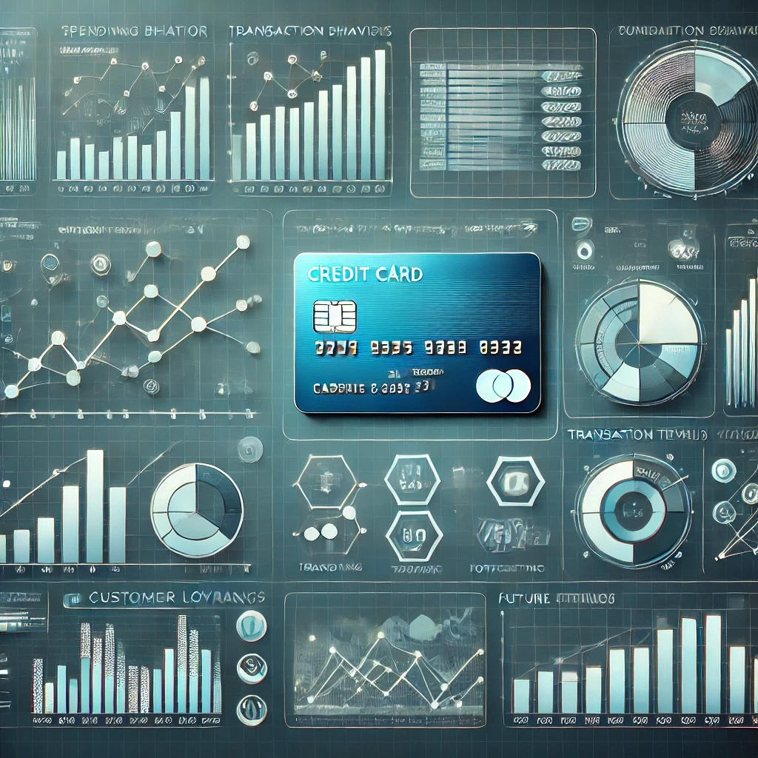
Credit Card Spending Behavior Analysis
A deep dive into customer loyalty, transaction trends, and forecasting

Slide 2

Spenderlytics Overview
Our software company specializes in analyzing credit card transaction data to provide actionable insights, accurate forecasting, and intelligent dashboards that help companies make data-driven decisions.
Today, we will present how we can use your credit card transaction data to uncover trends, improve customer targeting, and forecast spending behavior.

Slide 3
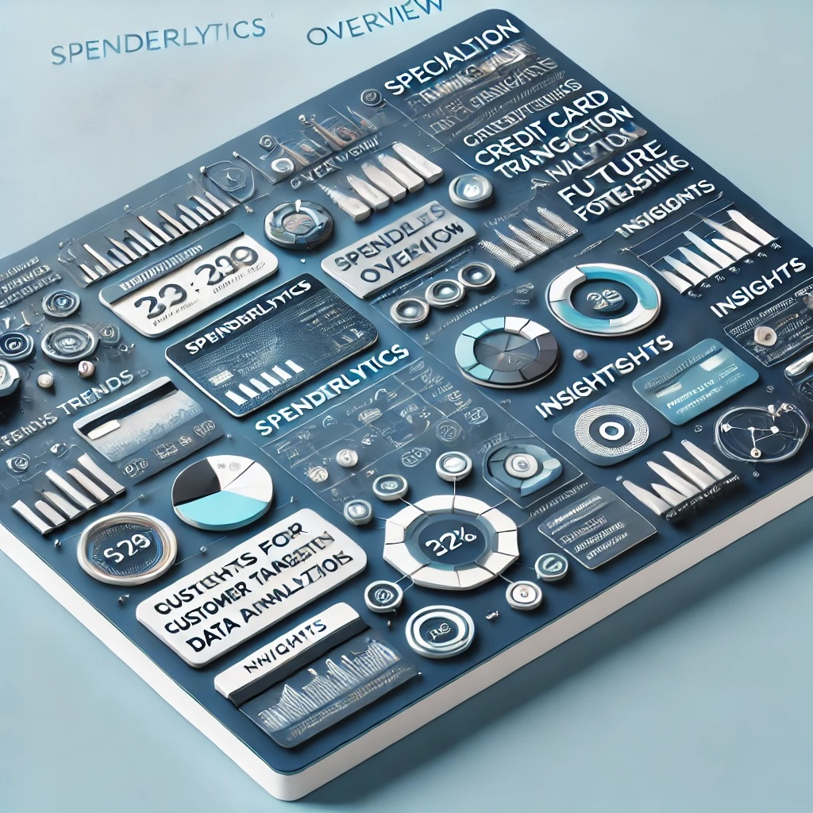
Founding Team
Asif Khan
Jason Brooks
Amit Gaikwad
Kade Thomas
Simranpreet Saini

Slide 4
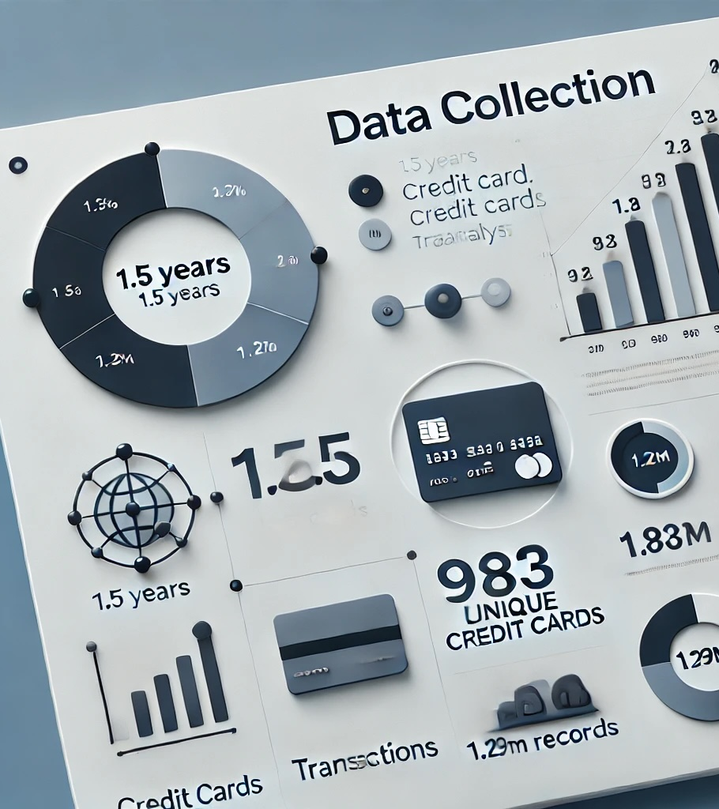
Data Source:
Kaggle (Credit Card Transactions Dataset)
Data Columns:
Date: Transaction date & Time
Credit Card Number
Amount: Transaction amount.
Merchant
Category: Spending category (e.g., Groceries, Dining, Travel, etc.)
Geo Information: State/City/Population
User Info: Gender/Job/Age
Data Size:
1.5 years
983 Unique Credit Cards
1.29M records

Slide 5
Key Analysis Areas
Customer Loyalty
Age Segmentation
Fraud
Marketing Opportunities
Merchant Analysis
Lifetime (LTV) Value

Slide 6
Customer Loyalty Analysis
Notes:
Customer loyalty is defined by analyzing three key metrics: frequency, recency, and spending behavior.
Frequency, Recency & Average Spending Thresholds: set by percentile to define:
Low
Moderate
High
Very High

Slide 7
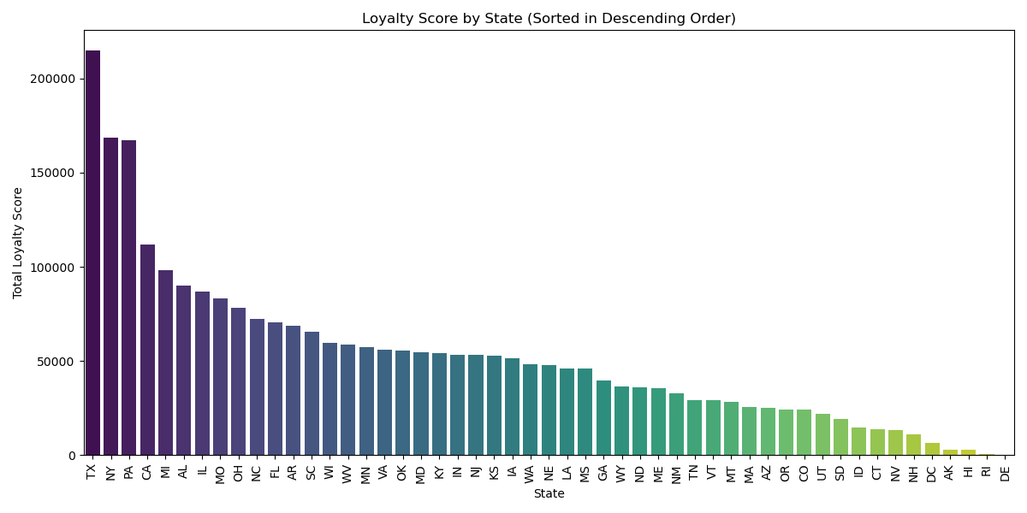
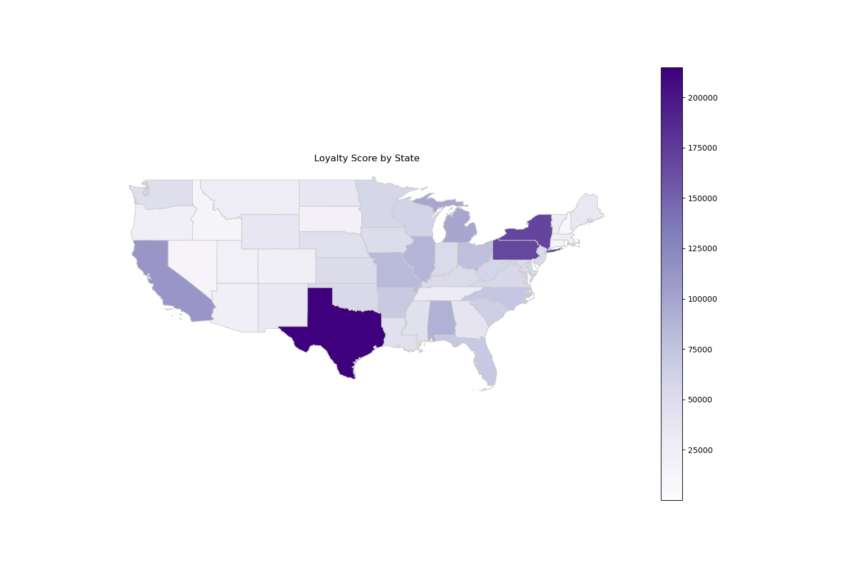
Notes:
Key findings:
TX, NY, PA & CA dominate in the loyalty scores (one reason can be population)
Significant potential in most of the states except the lower populated states like Alaska, Hawai & Delaware

Slide 8
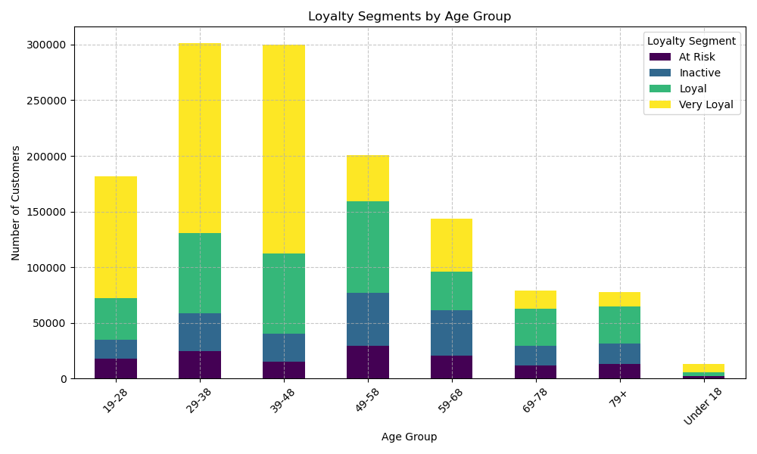
Notes:
Key Findings:
Highest loyalty in Age groups: 29-28 and 39-48
Loyalty is decreasing by Age group

Slide 9
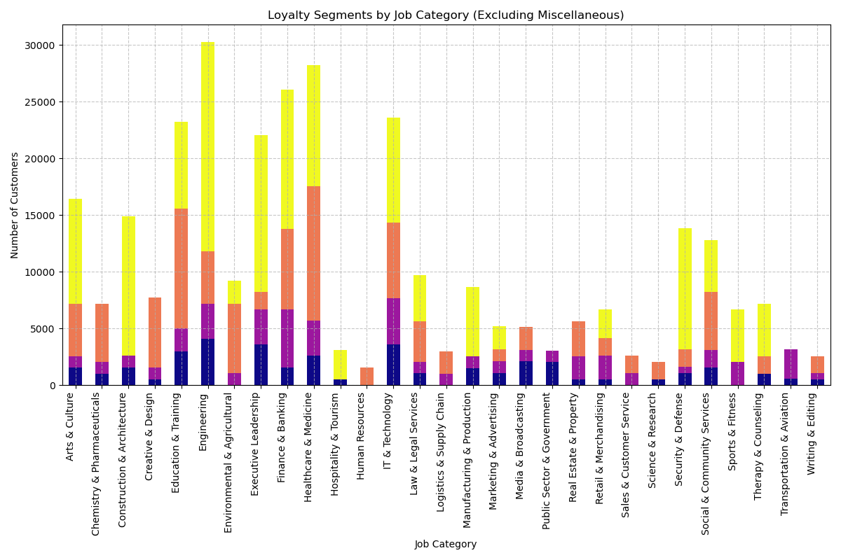
Notes:
Key Findings:
High loyalty in Technology, Executive Leadership and Finance
Loyalty distributed across multiple job categories, but significant clusters in high-earning or high-responsibility roles.
Recommendations:
State: Regional campaigns to boost and retain loyalty
Age: 29-48: Personalized financial products like family rewards & home improvement incentives
Job: Profession specific credit card to be marketed at conferences and networking events.

Slide 10
Age Segmentation Analysis

Slide 11
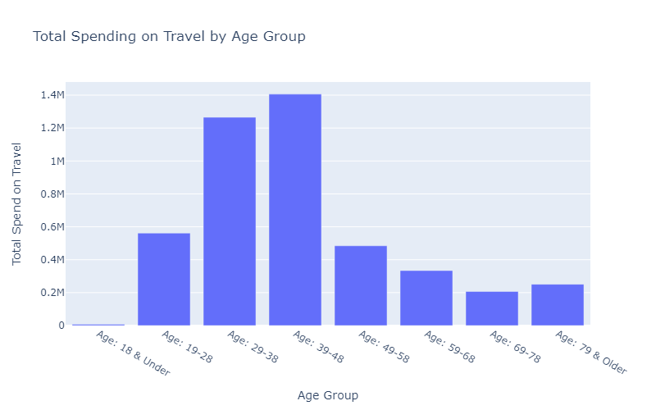
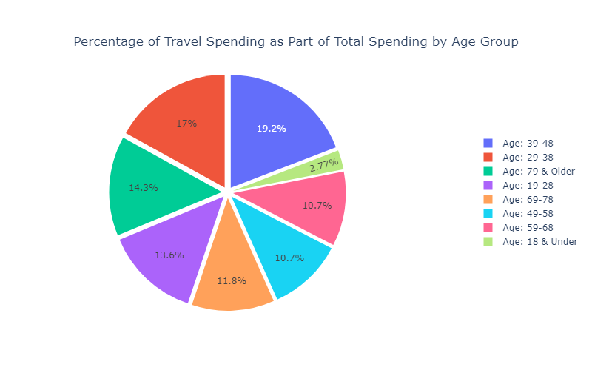
Travel Spend Opportunities
Target Ages : 49-58, 58-68, 69-78
Tailored Reward Points Incentives: 3X points on travel spend
Complimentary Travel Insurance
Family Bonus : 3+ more airline ticket purchases – 5000 points
Health and Wellness Travel Perks : Partner with Spa Resorts, Health Retreats, Medical Travel

Slide 12
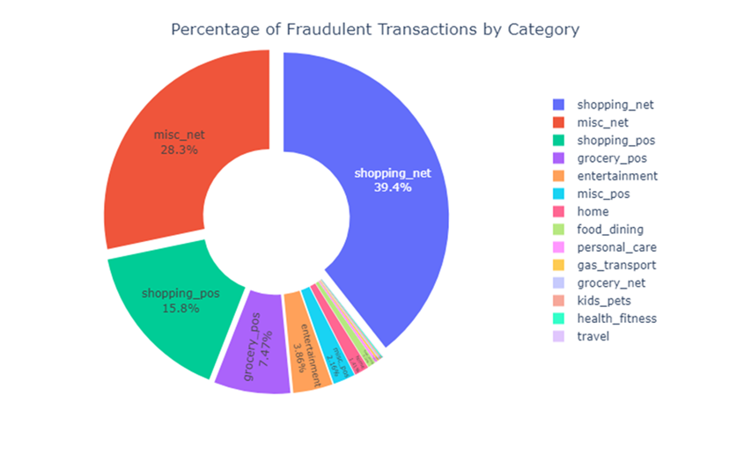
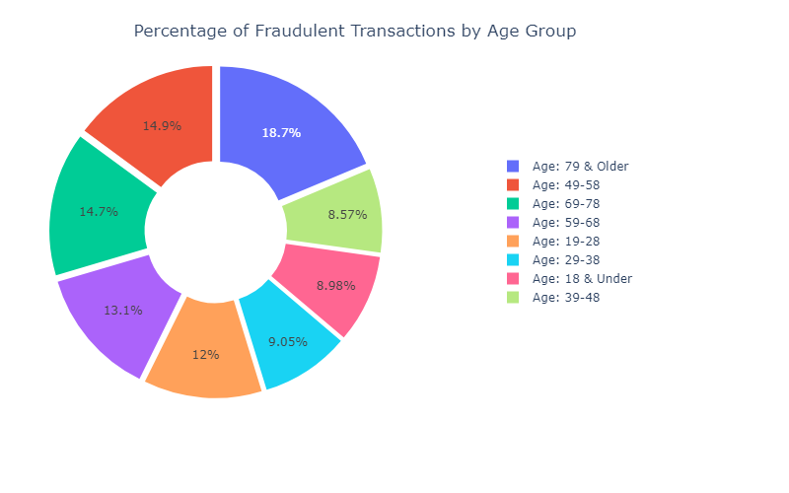
Fraud Among the Ages
Target Ages and Categories: 79 & Older – 67.7% Fraud transactions online shopping (misc_net, shopping_net
Increase security of online shopping
Dynamic MFA
Biometrics
Make OTP mandatory
Tokenization
AI “Smart Guard” – analyzing spending patterns in real time

Slide 13
Marketing Opportunities& Fraud Forecasting

Slide 14
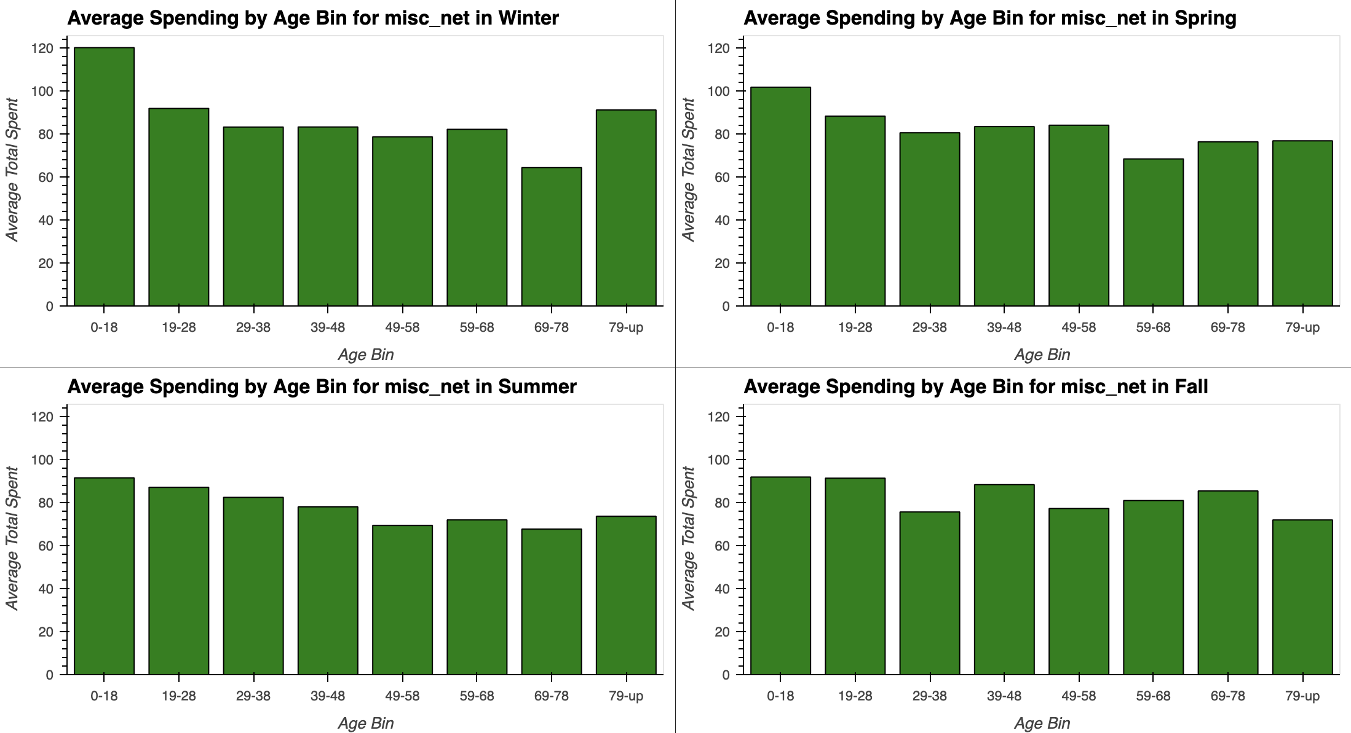
Marketing Opportunities

Slide 15
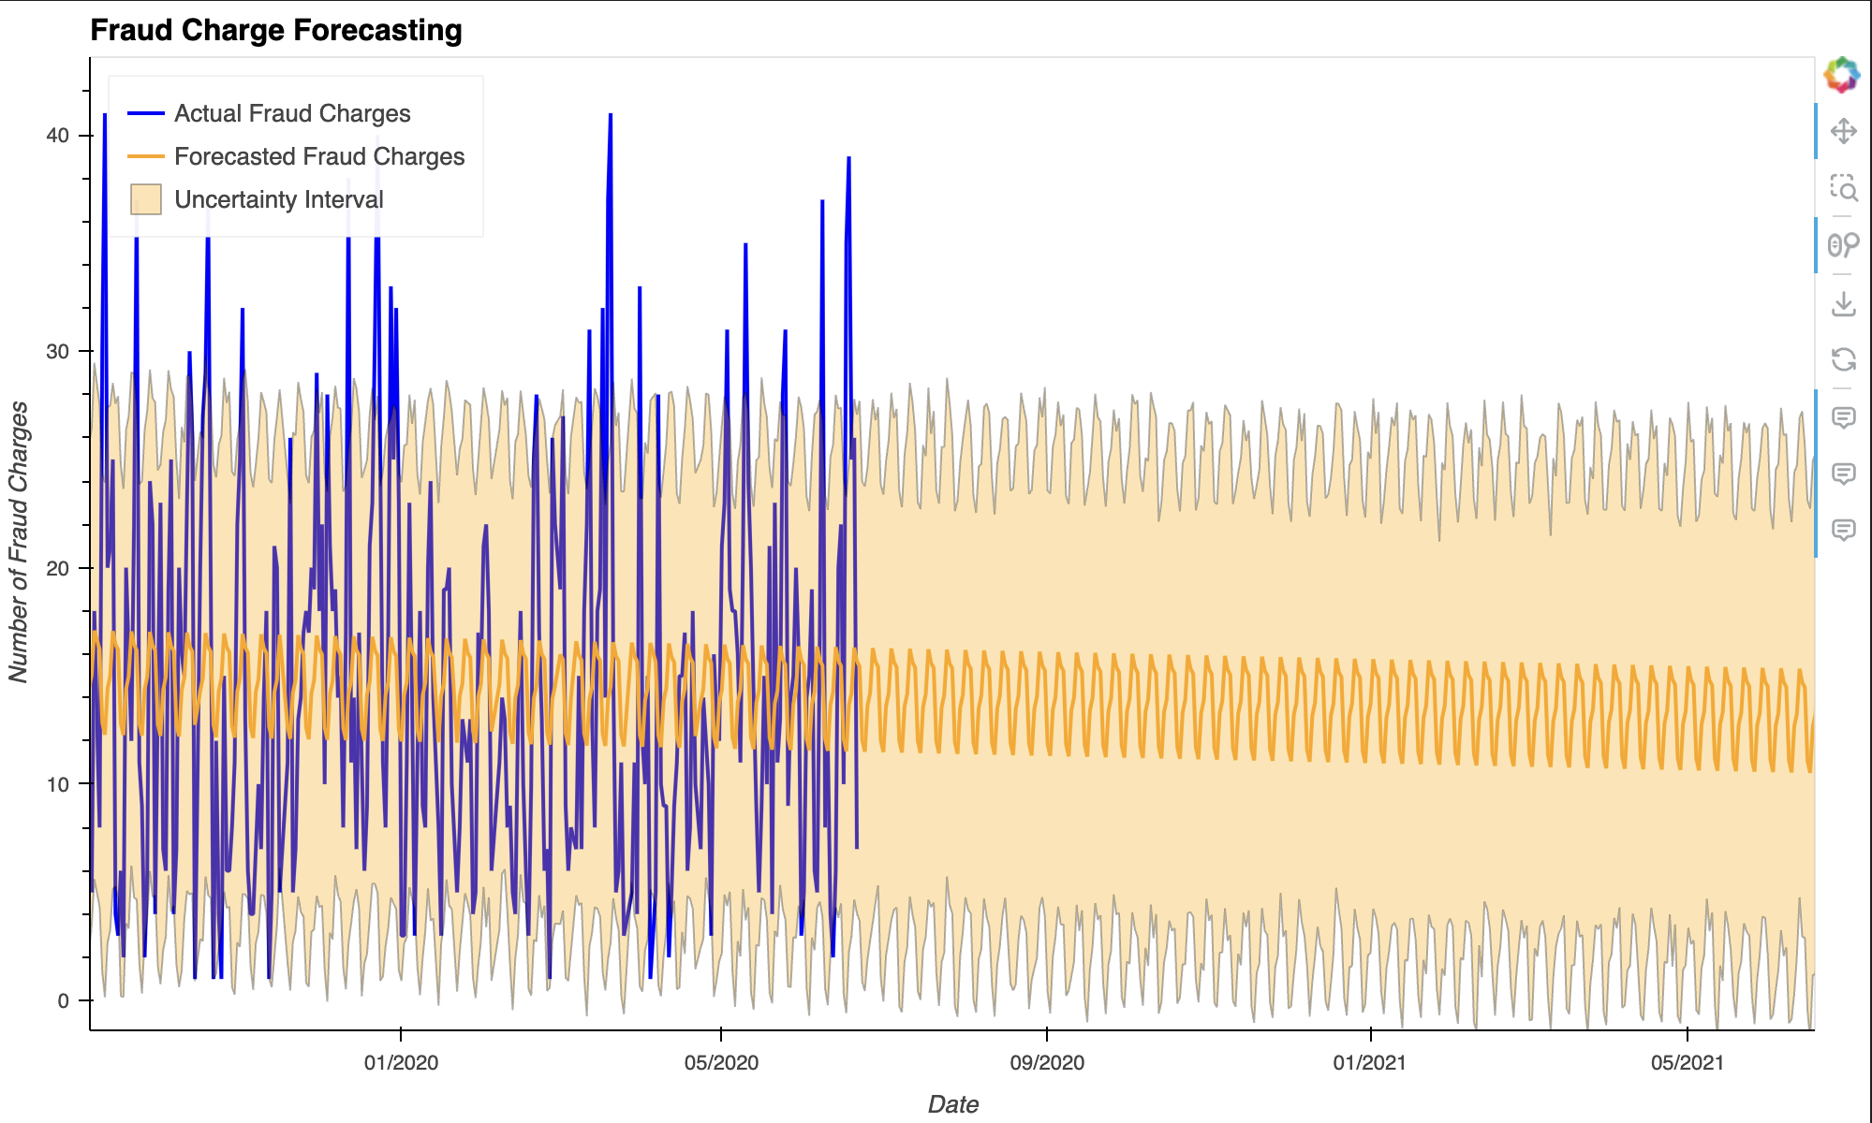
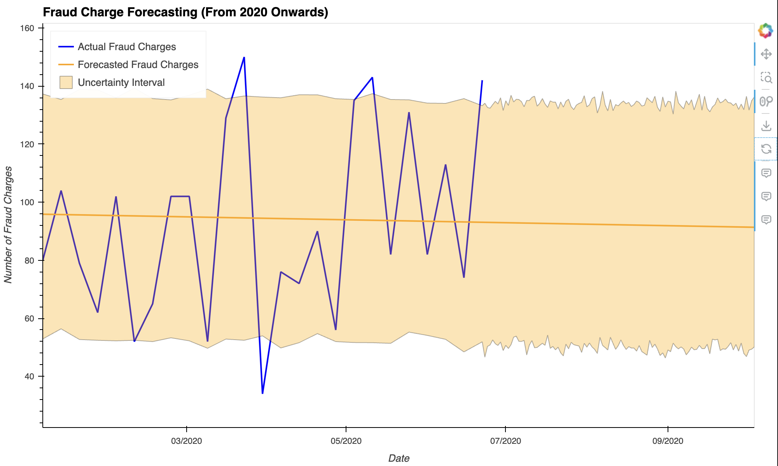
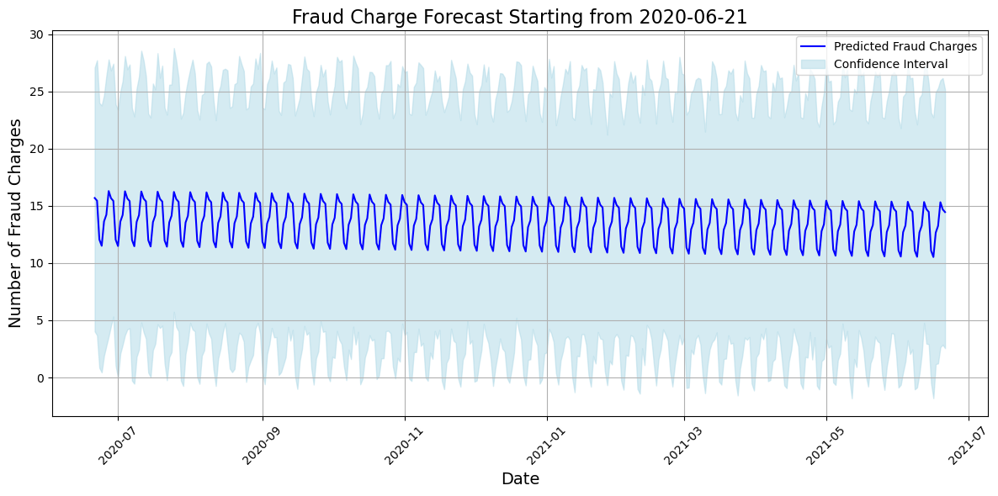
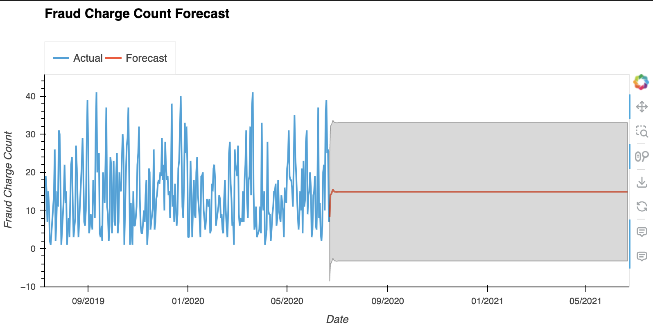
Fraud Forcast
Neural Prophet, Prophet, and ARIMA models
Excessive outliers
Daily fraud range:

Slide 16
Spending Behavior by Merchants

Slide 17
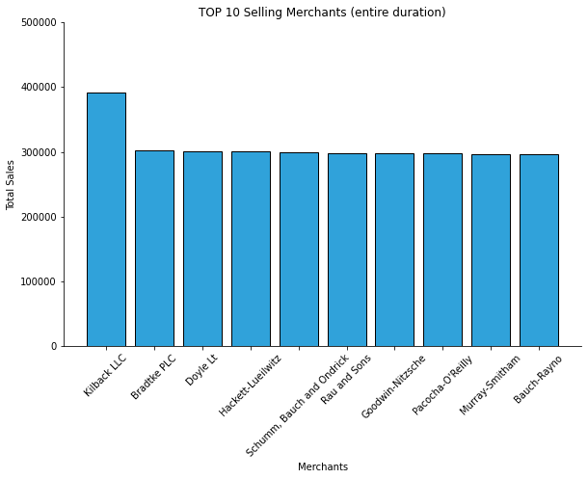
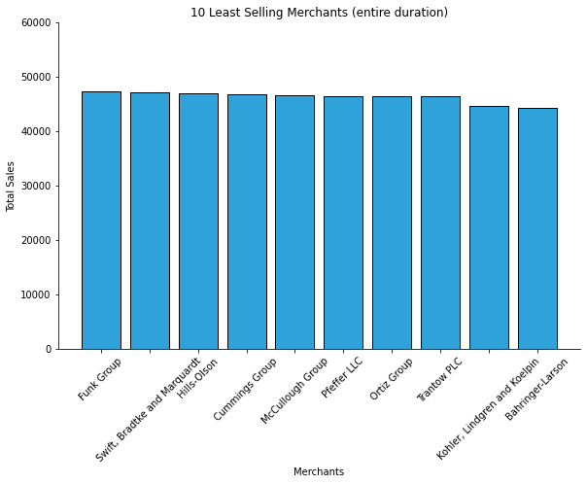
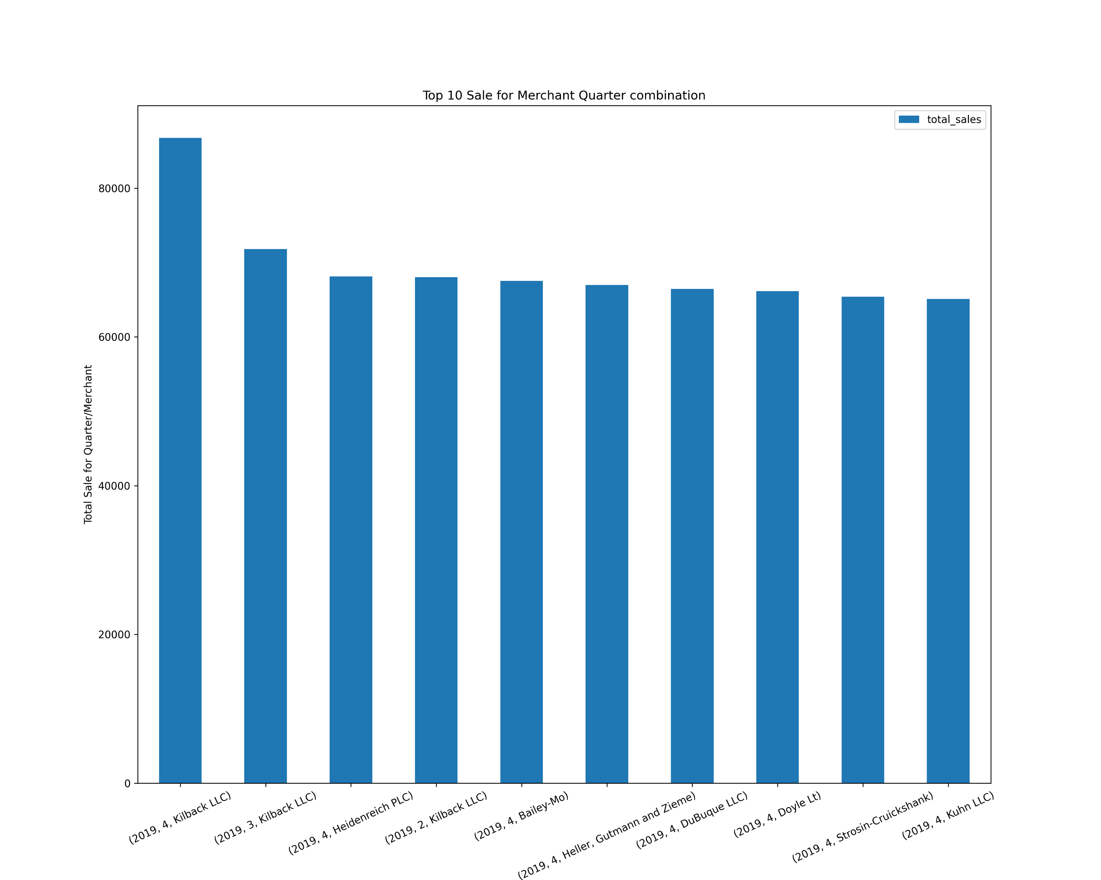
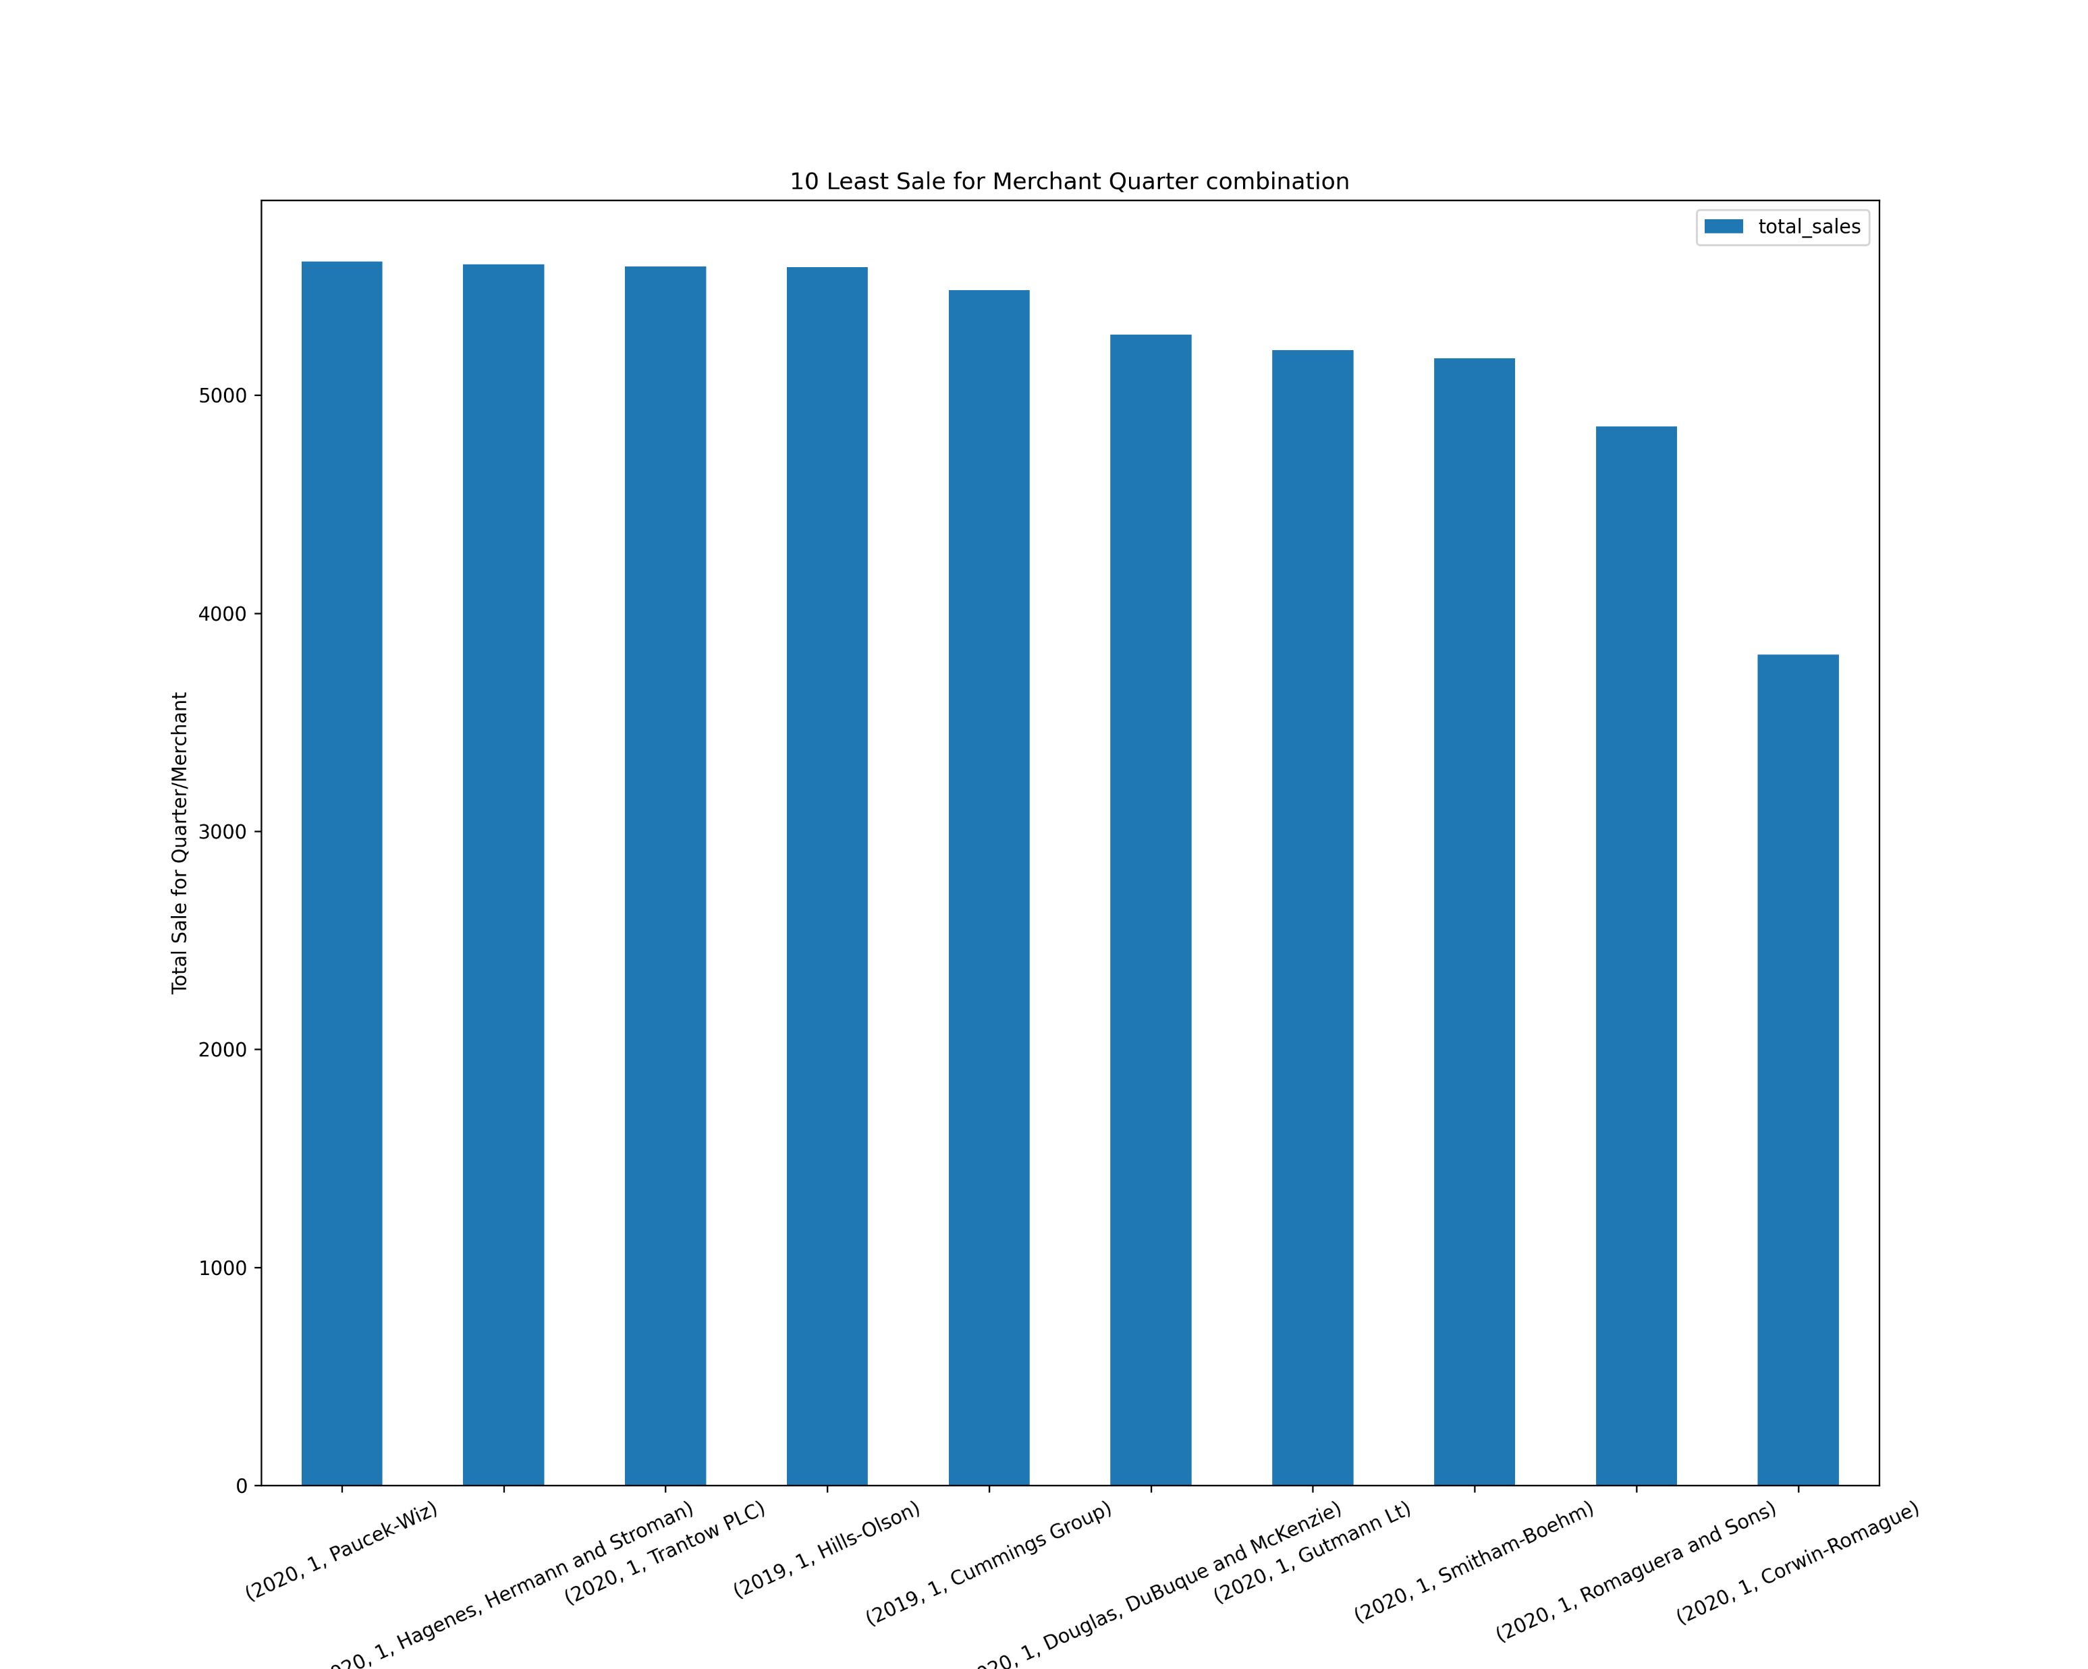
Merchant Sales Performance Overview
Top and Least Ten Selling Merchants for entire duration.
Market Trends and Insights
Potential Market Trends: Identify emerging trends based on sales data.
Areas of Improvement: Strategies for lower-performing merchants.
Strategic Partnerships: Form partnerships with top-performing merchants and provide support to lower-performing ones
Top and Least Ten Selling Merchants for quarter.

Slide 18
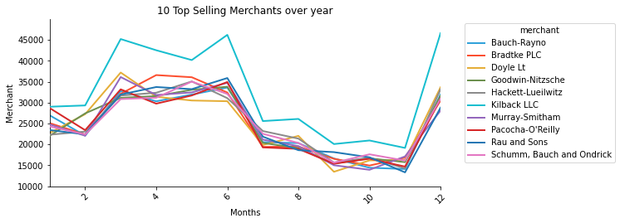
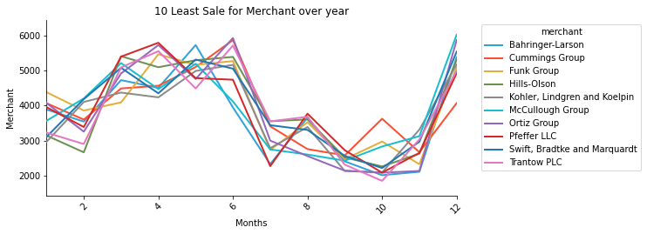
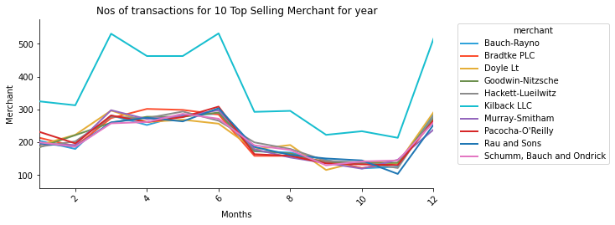
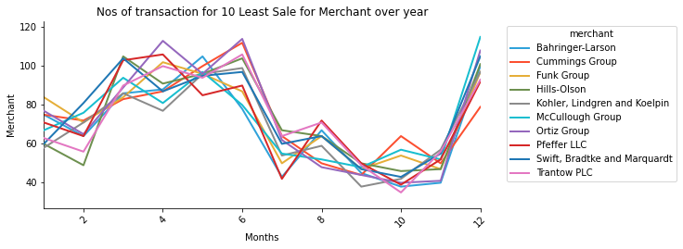
Merchant Sales Performance Overview (contd.)
Top and Least Ten Selling Merchants for year
Top and Least Ten Transactions for Merchants for year.

Slide 19
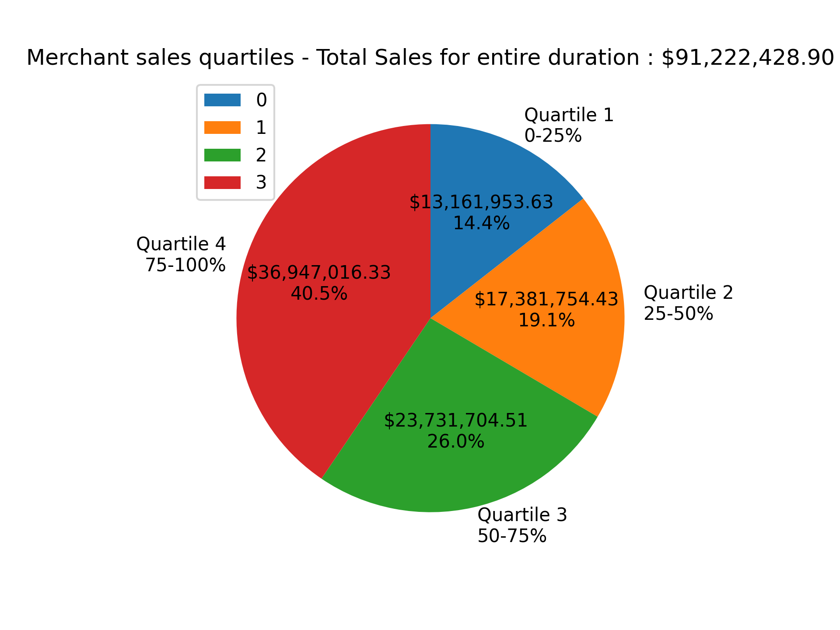
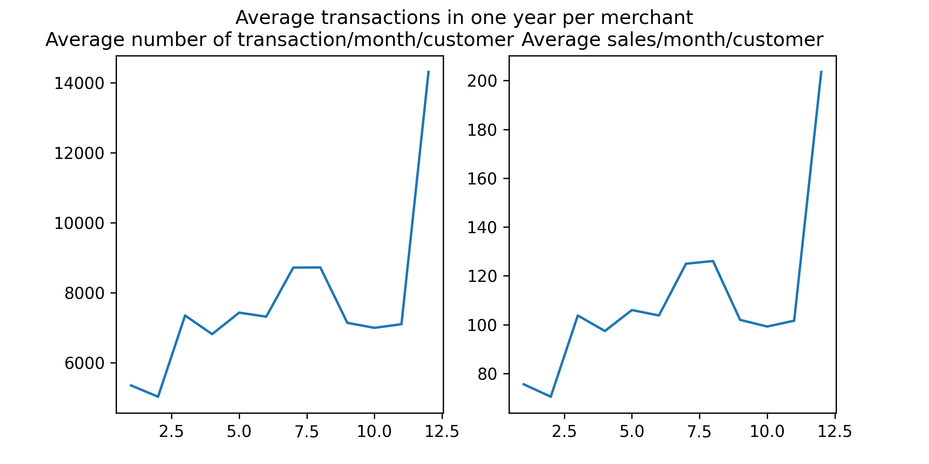
Total sales for all merchants in a year
Average number of transactions per month for merchant
Average sales per month for merchant
4 Quartiles distribution of merchant sales

Slide 20
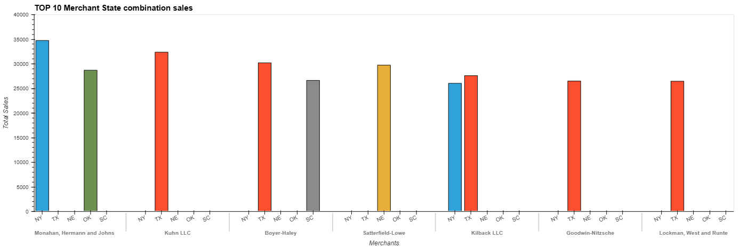
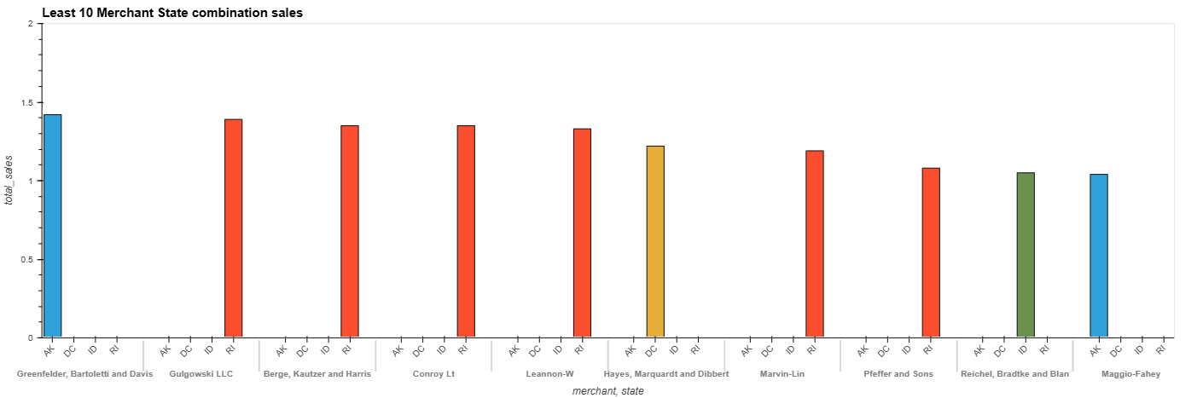
Top & Bottom Ten sales for merchant state wise

Slide 21
Lifetime Value (LTV) Forecasting

Slide 22
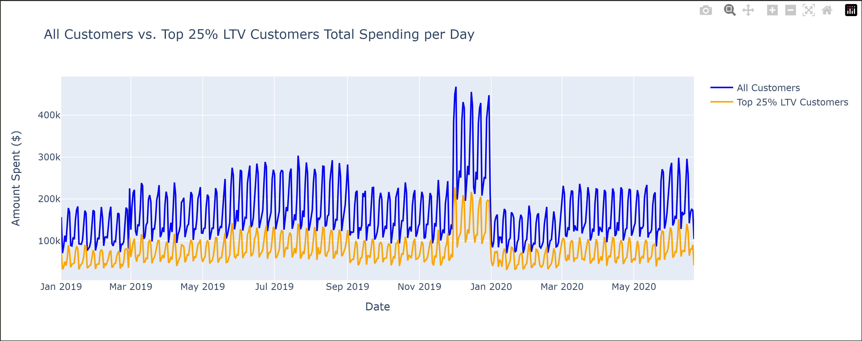
Top 25% LTV vs All Customers

Slide 23
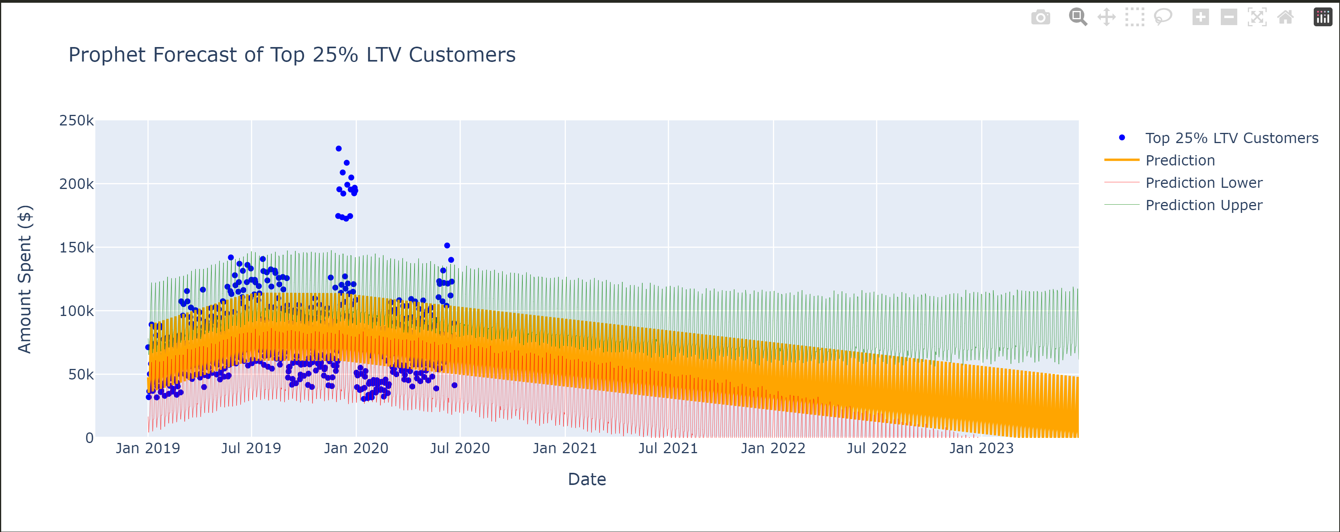
Prophet Forecast

Slide 24
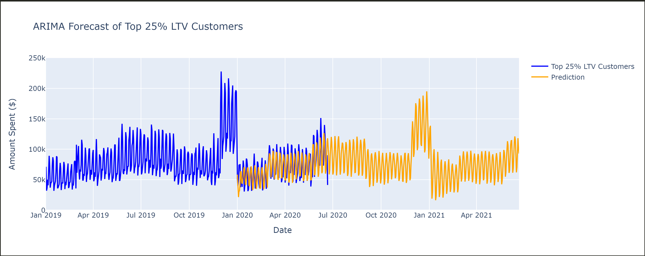
ARIMA Forecast

Slide 25
Future Improvements

Slide 26
Advanced Segmentation using ML & AI
Real-Time Data Integration
Customer Dashboards
Generalized App

Slide 27

Thank You!
Website & Social Media Coming Soon…

